Slide 1

Global Warming
And Its Causes
A sample size of 29 years for the entire world

Slide 2
Introduction
Peer Reviewed Opinions
Greenhouse Gas do have a partial effect on the Average Surface Temperature of the world. (Wang, 2020).
The effect of Carbon dioxide (CO2), a major component of Greenhouse Gases, on Global Warming is greatly exaggerated.(Zhao, 2011)
Climate change does not elicit sufficient fear or dread to motivate action.(Weber, 2020)
The relationship between Greenhouse Gases, Land Cover changes, and Average Surface Temperature Change (Global Warming ).
Extent to which Greenhouse Gas emissions and Land Cover Change are responsible for Global warming.
Impact on Approaches to solving Global warming

Slide 3
Research Question
Global warming. Are Greenhouse Gases its most important contributor?
1. Is change in Land cover associated with Annual Surface Temperature Change of the world?
2. Is change in Green House Gas Concentrations associated with Annual Surface Temperature Change of the world?

Slide 4
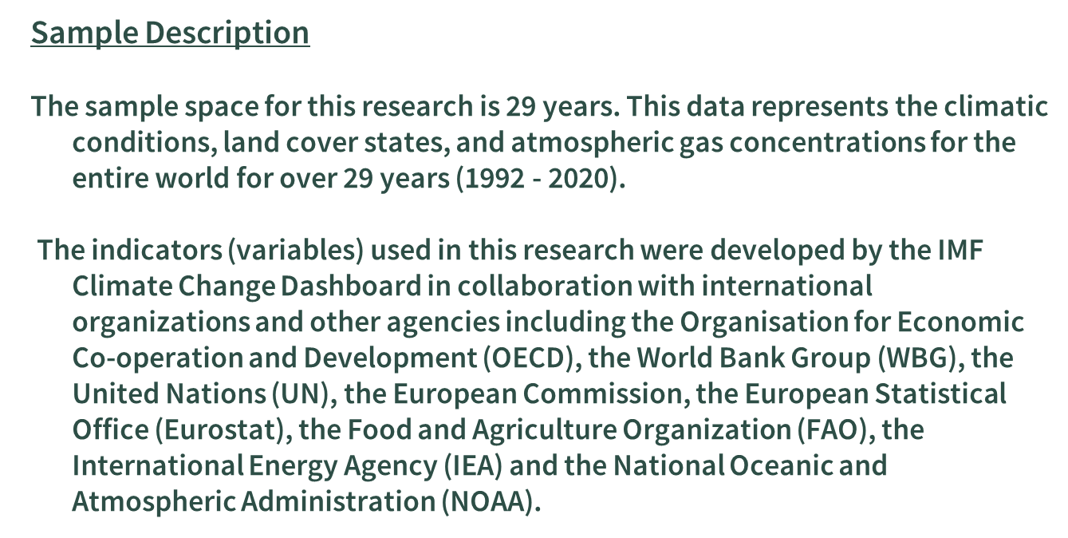
Methods
Land Cover Index:
This variable is a measure of the changes in land cover that are climate-altering over time. Climate Altering Land Cover Index (CALCI) reflects the changes in the share of climate-altering land over as compared to the base year, 2015. The climate Altering Land Cover Index is unitless.
Inferential Test
Pearson's correlation coefficient.
Normality of Variables
Linear nature of Bivariate distributions
Independence of variables
“Is change in Green House Gas Concentrations associated with Annual Surface Temperature Change?”
Ho`= There exists no linear correlation between Green House Gas Concentrations and the Surface Temperature change for the years 1992 to 2020. r = 0.
Ha` = There exists a linear correlation between Green House Gas Concentrations and the Surface Temperature change for the years 1992 to 2020. r ≠ 0
“Is change in land cover associated with Annual Surface Temperature Change”
Ho = There exists no linear correlation between Land Cover Index and the surface temperature change for the years 1992 to 2020, r = 0.
Ha = There exists a linear correlation between Land Cover Index and the surface temperature change for the years 1992 to 2020. r ≠ 0
Green House Gas concentrations:
This variable is a measure of the Greenhouse Emissions produced by the energy industry worldwide for the years 1970-2021. Estimates of emissions are in million metric tons of CO2 equivalent.
Average Surface Temperature Change:
This variable is a measure of mean surface temperature change with respect to the baseline climatology globally in in Degree Celsius, corresponding to the period 1992 to 2020 . This data is based on data provided by the Global Surface Temperature Change data distributed by the National Aeronautics and Space Administration Goddard Institute for Space Studies (NASA-GISS).

Slide 5
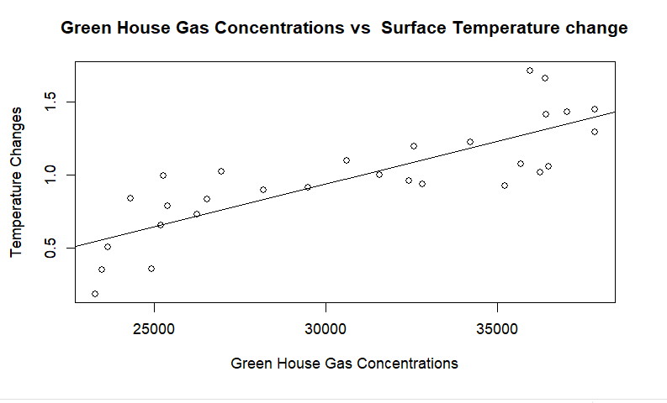
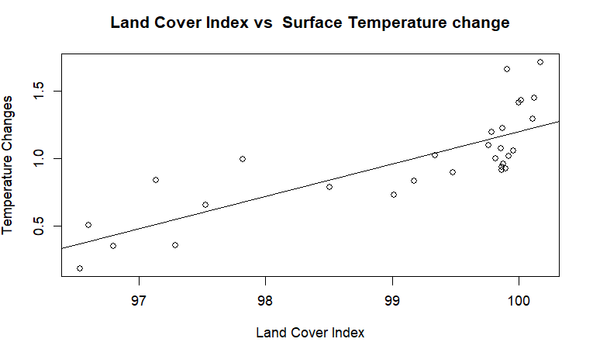
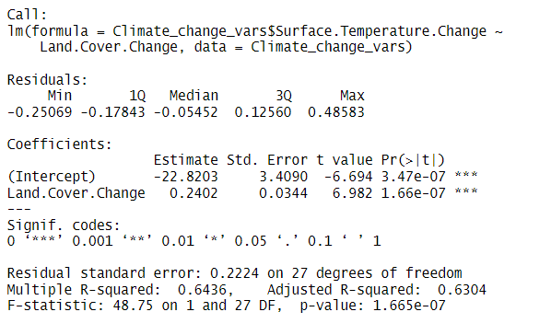
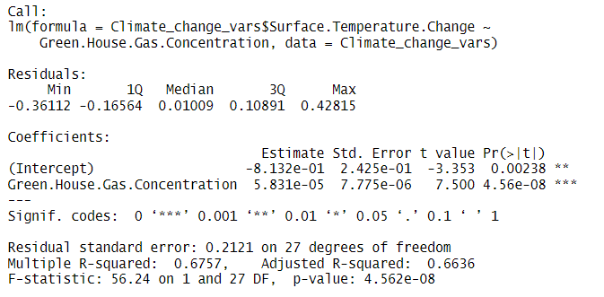

Bivariate analysis
For the assumed relationship between Green House Gas Concentration and Surface Temperature change the Coefficient of correlation equals 0.8219796 and r^2=0.6756504
Given a significance level 𝛼 = 0.05 and a p-value of 4.562e-08, For the assumed relationship between Green House Gas Concentration and Surface Temperature change for the years 1992 to 2020 we have strong evidence to reject H0.
The evidence establishes a strong positive linear relationship between Green House Gas Concentration and Surface Temperature change for the years 1992 to 2020. The evidence further suggests the Green House Gas Concentration accounts for 67.57% (r^2 = 0.67565046) of the variation in surface temperature.
For every 1 unit increase in Greenhouse gas concentration, there is 5.831e -1 increase in Surface Temperature change.
For the assumed relationship between the Land Cover Index and the Surface Temperature change the Coefficient of correlation “r” equals 0.8022386 and r^2 = 0.64358677
Given a significance level 𝛼 = 0.05 and a p-value of 1.665e-07, For the assumed relationship between Land Cover index and Surface Temperature change for the years 1992 to 2020 we have strong evidence to reject H0.
The evidence establishes a strong positive linear relationship between the Land Cover index and Surface Temperature change for the years 1992 to 2020. The evidence further suggests the Land cover index accounts for 64.36% (r^2=0.64358677) of the variation in surface temperature change.
For every 1 unit increase in Land Cover Index, there is a 0.2402 increase in Surface Temperature change.

Slide 6
Discussion
The results of this research show that there exists some valid relationship between Greenhouse Gas concentrations, Surface Temperature changes, and Land cover changes in the entire world from the year 1992 to 2020.
The level of correlation between the factors analyzed are extremely close which proves that Greenhouse gases, though significant in Global warming are not its most important factor.
“Second, there are many factors that may influence the climate change, and it is necessary to do some sensitivity experiments to detect the main factors and minimize the uncertainty”. (Zhihui, 2013)”

Slide 7
Discussion
Application
The possible research finding can be used to inform government decision making and daily living
Limitation
Small sample space (29 years)

Slide 8
Discussion
References
Wang, Y., Feng, J., Dan, L., Lin, S., & Tian, J. (2020). The impact of uniform and nonuniform CO2 concentrations on global climatic change. Theoretical & Applied Climatology, 139(1/2), 45–55. https://doi.org/10.1007/s00704-019-02924-7
Zhihui Li, Xiangzheng Deng, Qingling Shi, Xinli Ke, & Yingcheng Liu. (2013). Modeling the Impacts of Boreal Deforestation on the Near-Surface Temperature in European Russia. Advances in Meteorology, 1–9. https://doi.org/10.1155/2013/486962
Zhao, X. (2011). Is Global Warming Mainly Due to Anthropogenic Greenhouse Gas Emissions? Energy Sources, Part A: Recovery, Utilization, and Environmental Effects, 33(21), 1985–1992. https://doi.org/10.1080/15567030903515013

Slide 9
Thank You

